Slide 1
Measuring Religion In the Korean General Social Survey
Jerry Z. Park and Kenneth R. Vaughan
Baylor University

Slide 2

Criticisms of US Conventions for Studying religion
Affiliation
Social & personal practice
Personal Beliefs
Christian-centric / Protestant biased
Congregational focus
US focus

Slide 3
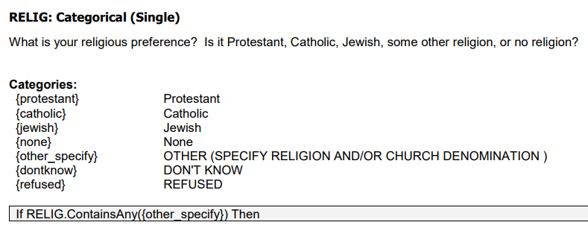
Comparing US Religion and Korean Religion
KGSS, 2016
US GSS, 2016

Slide 4
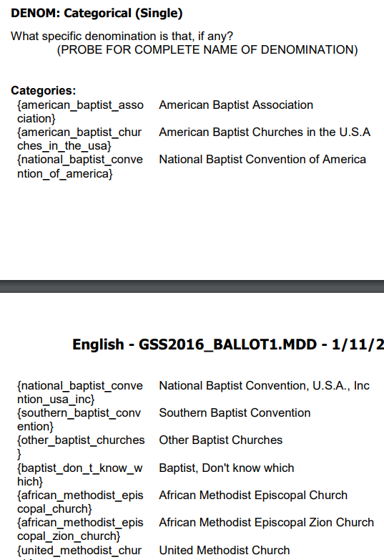
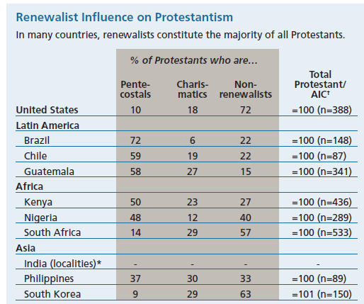
Denominational Disaggregations
US: Protestant/ Christian disambiguation
Korea: Buddhist, Protestant disambiguation?
  Buddhist Denominations/ traditions: Chogye, Son, Won
  Protestant Denominations: Presbyterian, Methodist, Baptist
  Protestant Denominations II: charismatic/ Pentecostal
Global Pentecostalism
Pew Research Center, 2006

Slide 5
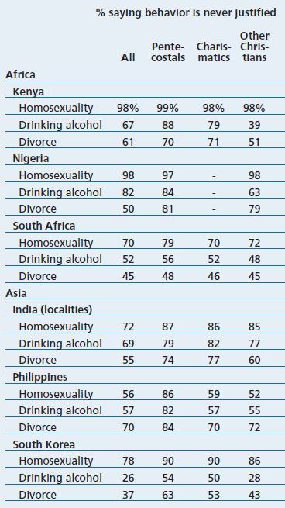
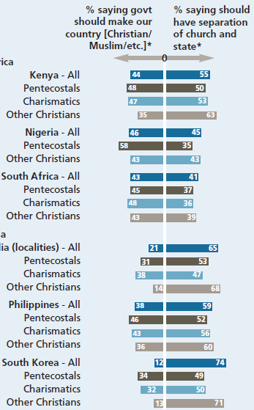
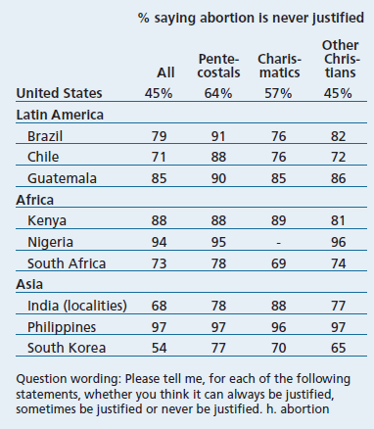
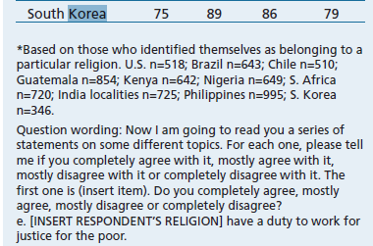
Expanding Categories: Charismatic Pentecostal Christians
Buddhist diversity?
(Son: Chogye, Taego; Won)
Other notable religions?
(e.g. Unification Church)

Slide 6
Expanding Affiliation Categories: Confucianism as Religion?

Slide 7
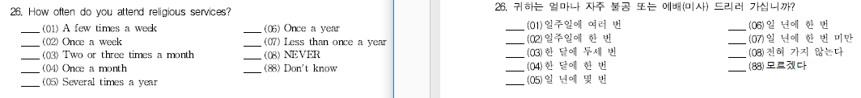
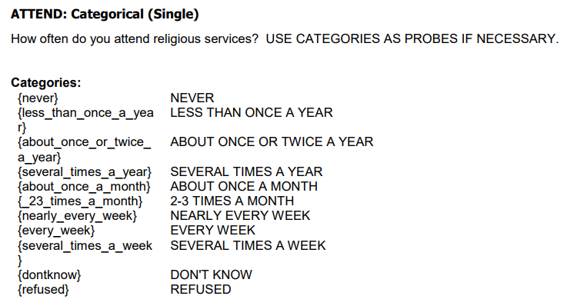
Indicators of Religiosity: Practice
KGSS, 2016
Alternative metrics for social dimension of religion?
Buddhist communal mantra, bowing meditation, recitations
US GSS, 2016

Slide 8
Ancestor Veneration as Private and Familial Religious Practice
Identification

Slide 9
Ancestor Veneration as Private and Familial Religious Practice
Practice

Slide 10
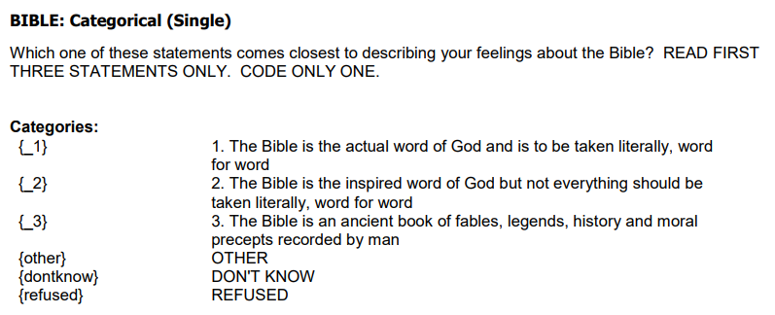
Indicators of Religiosity: Belief
(US) Conservative Christian belief strongly associated with:
  Political attitudes
  Social attitudes
(Korean) Christian equivalent?
(Korean) Buddhist equivalent?
(Korean) Confucianist equivalent?

Slide 11
Summary
Korean religious distribution warrants changes to KGSS religion questions
  Diversification within Christianity
  Diversification within Buddhism
  Inclusion of Confucianism
  Qualitative: inclusion of unique Korean religions
Korean religious practices warrant changes to KGSS religion questions
  Personal: Ancestor veneration, Buddhist practices
  Social: Buddhist communal practices
New: Korean national identity and religion

Slide 12
Measuring Religion In the Korean General Social Survey
Jerry Z. Park and Kenneth R. Vaughan
Baylor University

