Slide 1
Religion and Wellbeing: Viewpoints and Perspectives of Recent Research in Japan
Yoshihide Sakurai
Graduate School of Letters, Sociology
October 12, 2017

Slide 2
Outline
1 Well-being in East Asia
2 Review of literatures on well-being and religion
3 Research
  Data
  Analysis and results
  Implications
4 Future research

Slide 3
National Average Happiness
-WORLD HAPPINESS REPORT 2015-16
GDP and Happiness
Ranking of Happiness 2015
World Ranking 2016
 | GDP | Happiness
China | 2 | 83
Japan | 3 | 53
Korea | 11 | 58
Indonesia | 16 | 79
Taiwan | 22 | 35
Thailand | 27 | 33
Hong Kong | 34 | 75
Malaysia | 35 | 47
Singapore | 39 | 22
Philippines | 40 | 82
Vetnam | 50 | 96
World Happiness Report 2016
The Earth Institute Columbia University
Regressions to Explain National Average Happiness: Log GDP per capita, Social support,
Healthy life expectancy at birth, Freedom to make life choices, Generosity, Perceptions of corruption
Notes:
Let us take a look at our subjective happiness by nations in 2014. As left figure shows, Top country is Switzerland and the bottom is Syria, which has civil war and suffered lot. High ranking countries in happiness are Europeans and North American. East Asian countries are behind Thailand, they are below 40th.
World Happiness Report 2015 analyzed that economic condition, social support, life expectancy, and freedom of make life choice reinforced subjective happiness. Compared wellbeing with GDP, East Asian countries such as Japan, Korea, China, Hong Kong, and South East Asian countries such as Indonesia, Malaysia, Filipinas, Vietnam show the gap between national wealth and individual happiness.

Slide 4
Well-being and individual/social conditions
Medical and nursing care
Social security and social capital
Mental health and Happiness
Physical Health
community
Life philosophy
Life attitude
Social norm and culture
Working place
Notes:
This figure shows my understanding of the relation between, Health, and Happiness, Well-being. Our consciousness of Well-being is composed of physical health, mental health, and social relations. The best mix of those three factors make our subjective well-being. Politics dealing with social security and social welfare supports our well-being. This is about what former researches on well-being so far pointed out.
Now that, I would like to add the role of religions to empower our well-being. And three papers after my introduction will be the cases.

Slide 5
Ruut Veenhoven’s “four qualities of life” and religions
 | Outer quality | Inner quality
Life chance | ①Livability of environment | ③Life-ability of persons
Life result | ②Utility of life | ④Appreciation of life
① FBO and FRO promote peoples’ life chance by social work.
② Religions provide social and spiritual resources.
③ Religions provide mental and social capital in their congregation.
④ Religions provide happiness by their teaching and ritual.
Notes:
Well-known scholar on happiness studies, Ruut Veenhoven made a quadrant of quality of life, in which he divided outer quality, social quality from inner quality, personal quality, and life chance, Weber’s concept of availability of social resource, and life result, satisfaction of living condition.
Religious organizations directly provide livable living condition by social work and provide mental capital and social capital in their religious communities.

Slide 6
Review of papers on SSSR 2001-2015
1 Schnittker, Jason, 2001, ‘When is Faith Enough?: The Effects of Religious Involvement on Depression,’ JSSR40-3:393-411.
2 Pargament, Kenneth I.2001, et all, ‘Religious Coping Among the Religious: The Relationships Between Religious Coping and Well-Being in a National Sample of Presbyterian Clergy, Elders, and Members,’ JSSR40-3:497-513.
29 Jong Hyun Jung, 2015, ‘Sense of Divine Involvement and Sense of Meaning in Life: Religious Tradition as a Contingency,’ JSSR54-1:119-133.
30 Clemens M. Lechner and Thomas Leopold, 2015, ‘Religious Attendance Buffers the Impact of Unemployment on Life Satisfaction: Longitudinal Evidence from Germany,’ JSSR54-1:166-174.
Notes:
When we studies in Journal of the scientific study of religions from 2001 to 2015, we found 30 articles that deal with well-being.

Slide 7
Findings
①Methodology is statistical analysis of general social survey.
②Religious factors such as attendance, belief, and human support in congregation generally have positive effect on subjective well-being.
③Especially for elders, underclass, and African-American.
④Coping effect for loss experience such as divorce/bereavement, illness, and unemployment.
⑤Chinese religions such as Buddhist and Taoist ritual, fortune telling, and folk karmic dogma have negative effect, and Japanese religions have ambiguous one.
Notes:
Findings are

Slide 8
Japanese literatures
Kaneko
  ISSP1998（Religion Ⅱ）
  In US positive impact of marriage, class consciousness, religious attitude, and education (in this order) on happiness
  In Japan class consciousness, marriage, and sex in this order, and no impact by religious belief
Kawabata
  ISSP2008
  Religion and happiness are correlated in almost countries
  In Japan no correlation, however, no unhappy person with religious belief.
Notes:
Japanese scholarship also study the relation between religion and subjective well-being, however, they could not find direct positive effect of religion on subjective well-being.

Slide 9
My research
Data:
  Multiple random sampling survey in Japan by a research company
  Interviewed respondents are 1200 persons.
Hypothesis:
  Religious belief and attitude should have a certain impact on subjective well-being in contemporary Japan.
Question:
  Comparing other social factors, to what extent does religion have impact to happiness of Japanese?
Notes:
I conducted my research with Prof. Carola Hommerich and Shimizu Koki. Using research company, we collected 1200 interviewed questionnaires.

Slide 10
Descriptive Results: Happiness and Health
Notes:
Samples show relative high level of happiness, health as well.

Slide 11
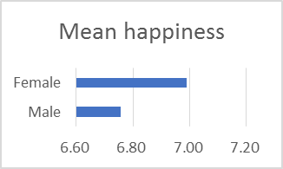
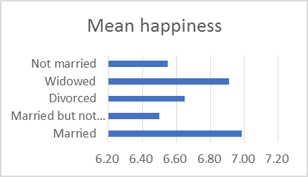
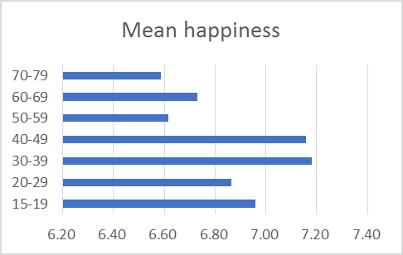
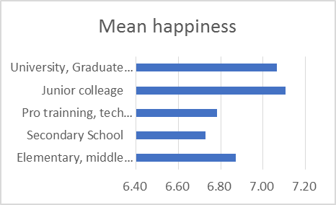
Descriptive Results: sex, age, married or not, school career
Notes:
Female feels happier than male, Married and widowed people happier than not married and divorced. Middle agers and Junior college graduates feel happier.

Slide 12
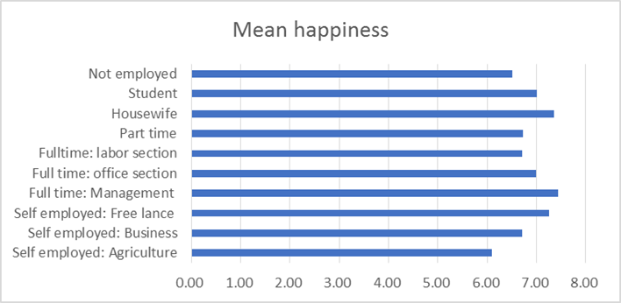
Descriptive Results: job
Notes:
House wife and manager seem to be happiest people.

Slide 13
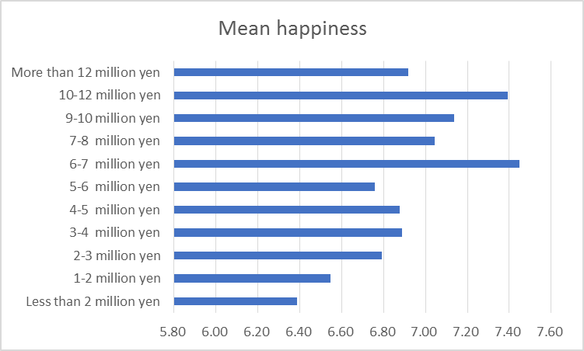
Descriptive Results: annual household income
1 million yen is US$ 8,881.
Notes:
Upper middle class feels happier than lower middle and underclass.

Slide 14
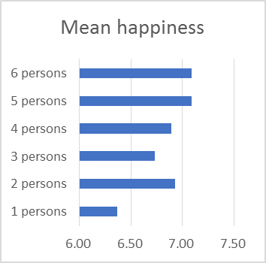
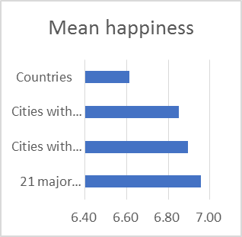
Descriptive Results: Number of family members and Living city size
Notes:
More family members, more happy. Big city dwellers feel happier than local dwellers.

Slide 15
Factor Loadings and Communalities based on a Factor Analysis with Varimax Rotation for 12 Items of Religious Behavior
 | Customary religious | institutionally religious | spiritual and occult
joining in religious activities | -.083 | .794 | .037
joining in religious meeting | .033 | .927 | .003
reading bible and other religious canon | .051 | .674 | .107
visiting to shrine in new year | .553 | -.193 | .116
visiting to ancestral tomb in Bon and equinoctial week | .487 | .006 | -.001
joining in local festival | .494 | .084 | .039
visiting shrines and pilgrimage | .793 | -.041 | .109
receiving amulets and talismans | .586 | -.051 | .229
praying for Gods and/or Buddha | .502 | .241 | .176
visiting to sacred places | .196 | -.004 | .511
visiting to therapists and counselors | -.009 | .080 | .654
visiting to fortune tellers | .143 | .058 | .572
Contributions: institutionally religious =19,774custamary religious =17.790 spiritual and occult =7.037
Notes:
By factor analysis I categorized three groups of religious activities and beliefs. First one is customary religious activities such as visiting shrine and temple and practicing folk rituals. Japanese does not recognize their activities religious. Second is institutionally religious activities such as joining religious groups and reading canon. Third is spiritual and occultist activities such as visiting sacred place and receiving counseling by therapist.

Slide 16
Result of multiple logistic regression analysis on happiness
 | Model 1 |  |  |  |  | Model 2 |  |  |  |  | Model 3 |  |  |  |  |  | Model 4
 | b |  | SE | β |  | b |  | SE | β |  | b |  | SE | β |  |  | b |  | SE | β
Intercept | 6.49 | *** | .261 |  |  | 3.25 | *** | .372 |  |  | 5.19 | *** | .321 |  |  |  | 1.72 | *** | .613
Sex (Female） | .274 | ** | .114 | .074 |  | .234 | ** | .108 | .063 |  | .251 | ** | .113 | .067 |  |  | .204 |  | .130 | .055
Age | -.006 | * | .003 | -.053 |  | .002 |  | .003 | .020 |  | -.007 | ** | .003 | -.068 |  |  | -.002 |  | .004 | -.020
Education | .062 |  | .044 | .045 |  | .036 |  | .041 | .026 |  | .043 |  | .043 | .031 |  |  | .021 |  | .049 | .015
Household Income | .065 | *** | .023 | .093 |  | .053 | ** | .021 | .076 |  | .050 | ** | .023 | .071 |  |  | .044 | * | .026 | .063
Subjective health |  |  |  |  |  | 1.04 | *** | .090 | .346 |  |  |  |  |  |  |  | .928 | *** | .107 | .308
General trust |  |  |  |  |  |  |  |  |  |  | .608 | *** | .089 | .208 |  |  | .434 | *** | .102 | .148
Customary religious |  |  |  |  |  |  |  |  |  |  |  |  |  |  |  |  | .472 | ** | .200 | .090
Institutional religious |  |  |  |  |  |  |  |  |  |  |  |  |  |  |  |  | .418 | *** | .145 | .106
Spiritual and occultist |  |  |  |  |  |  |  |  |  |  |  |  |  |  |  |  | -.494 | ** | .221 | -.081
Memory of Ksitigarbha image |  |  |  |  |  |  |  |  |  |  |  |  |  |  |  |  | .067 |  | .130 | .018
Belonging to religions |  |  |  |  |  |  |  |  |  |  |  |  |  |  |  |  | -.185 |  | .166 | -.044
Adjusted R² | .019 |  |  |  |  | .131 |  |  |  |  | .060 |  |  |  |  |  | .162
N | 1053 |  |  |  |  | 1047 |  |  |  |  | 1036 |  |  |  |  |  | 734
*** p<0.001, **p<0.05, *p<0.1,
b=unstandardized beta coefficient, SE=Standard Error, β=standardized beta coefficient
Notes:
Take a look at model 4, results of multiple logistic regression analysis. When I controlled the effect of sex, age, education, household income, subjective health consciousness, and sense of social capital, we can look at the positive impact of customary religious and institutionally religious activities and negative impact of spiritual and occultist activities.

Slide 17
Correlation Matrix of happiness and religious attitude
 |  | Level of happiness | Institutionally religious | Customary religious | Spiritual and oculist
Level of happiness | Pearson’s R |  | .087** | .112** | -.009
 | Sig. |  | .003 | .000 | .764
 | N |  | 1182 | 1177 | 1184
Institutionally religious（Q15E, F, Mの平均） | Pearson’s R | .087** |  | .041 | .090**
 | Sig. | .003 |  | .158 | .002
 | N | 1182 |  | 1172 | 1179
Customary religious（Q15A, B, C, D, G, J の平均） | Pearson’s R | .112** | .041 |  | .279**
 | Sig. | .000 | .158 |  | .000
 | N | 1177 | 1172 |  | 1174
Spiritual and occultist（Q15I, K, L の平均） | Pearson’s R | -.009 | .090** | .279**
 | Sig. | .764 | .002 | .000
 | N | 1184 | 1179 | 1174
Notes:
ちなみに、この表からは「他の変数で統制しない場合でも、『制度的な宗教行動』および『慣習的な宗教行動』の指標は、『幸福感』と正の相関がある」ということが読み取れます。

Slide 18
Summary of analyses
The customary and institutional religious activities have positive impact to subjective well-being in Japan, however, spiritual and occultist one have negative one.
In contrast with former studies in Japan and East Asian countries, this study shows certain degree of religious function.
Still, another question is that Japanese traditional religions does not have congregations and how just customary religious attitude cope with distress among unbelieving people. This is sharp contrastive with the Christian based church model.

Slide 19
Future study
Are happy and unhappy polar opposite concept and emotion in human recognition and social consciousness?
  How can we make a measurement of relativistic and variable idea and emotion? How should we consider the difference between happy and satisfied in terms of material and spiritual resources?
Which people of unhappy, modest, and happy do religious activities have positive and negative impact to?
  Possible answers are conventionally to unhappy people. In this study I try to make unhappy-people group (under 4 N=247) and conduct regression analysis, however, the result is that any religious activities do not have any meaningful effects to their happiness. In contrast, among happy-people group (over 5 N=924) religious attitude function.

Slide 20
References:
Dedong Wei and Eric Y. Liu, 2013,’Religious Involvement and Depression: Evidence for Curvilinear and Stress-Moderating Effects Among Young Women in Rural China,’ JSSR52-2:349-365.
Ellison, G. Christopher, 1991,’Religious Involvement and Subjective Well-Being,’ Journal of Health and Social Behavior 32(1):80-99.
Roemer, Michael K., 2010, ‘Religion and Psychological Distress in Japan,’ Social Forces 89-2:559-583.
Ruut Veenhoven, 2000, ‘The Four Qualities of Life: Ordering Concepts and Measures of the Good Life,’ Journal of Happiness Studies 1: 1–39.
金児恵,2004,「日本人の宗教的態度とその精神的健康への影響 : ISSP調査の日米データの二次分析から」『死生学研究』3:348-367.
川端亮,2016,「宗教的信念における共通の因子－8カ国調査の結果から」『大阪大学大学院人間科学研究科紀要』42:189-208.
櫻井義秀,2017, 「特集 主観的ウェル・ビーイングへの社会学的アプローチ 人は宗教で幸せになれるのか」『理論と方法』32（1）80-95.
横井桃子・川端亮,2013,「宗教性の測定一国際比較研究を目指して」『宗教と社会』19:79-95.

