Slide 1


Who Are the “Unaffiliated” in East Asia?
A Presentation of Exploratory Data
Gina A. Zurlo, Ph.D.
Institute on Culture, Religion and World Affairs
International Religious Demography Project
Boston University

Slide 2
% of the world that is religious
Religionists
Non-religionists
Source: Todd M. Johnson and Brian J. Grim, World Religion Database. Leiden/Boston, Brill, accessed October 2017.

Slide 3
Unaffiliated?
Source: Todd M. Johnson and Brian J. Grim, World Religion Database. Leiden/Boston, Brill, accessed October 2017.

Slide 4
“None” in East Asia
Folk-religionists
Shamanists
Buddhists
Shintoists
Animists
Traditional religionists
“Do you belong to one of the organized world religions?”
Christianity, Islam, Judaism…

Slide 5
Uncovering affiliation
“Nothing in particular”
Belief/lack of belief
Self-identification
Prayer, religious service attendance, believes in God, gives money to religious organizations
Religious?

Slide 6
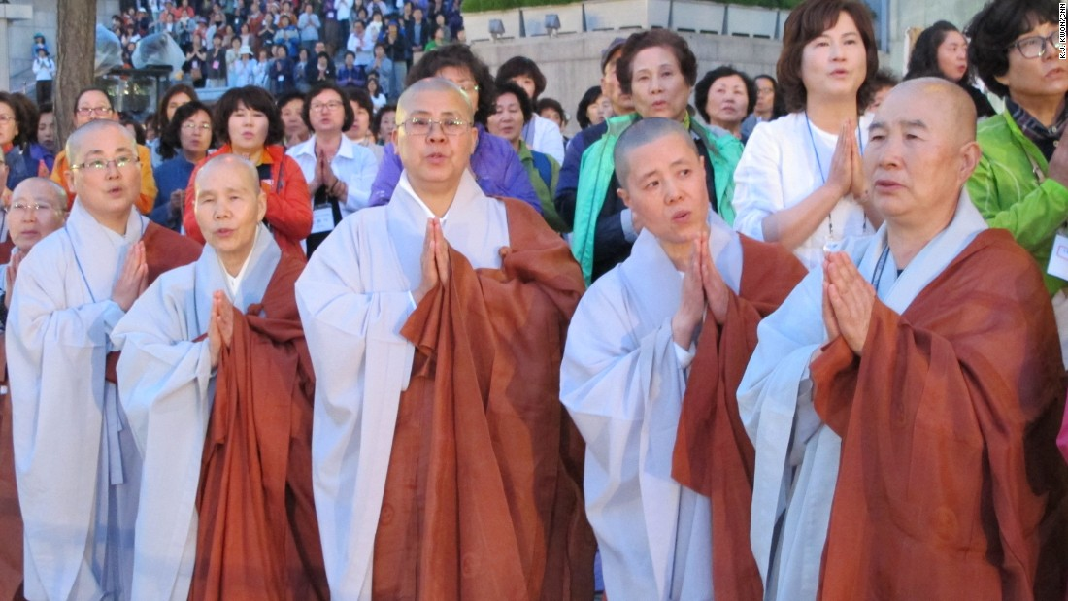
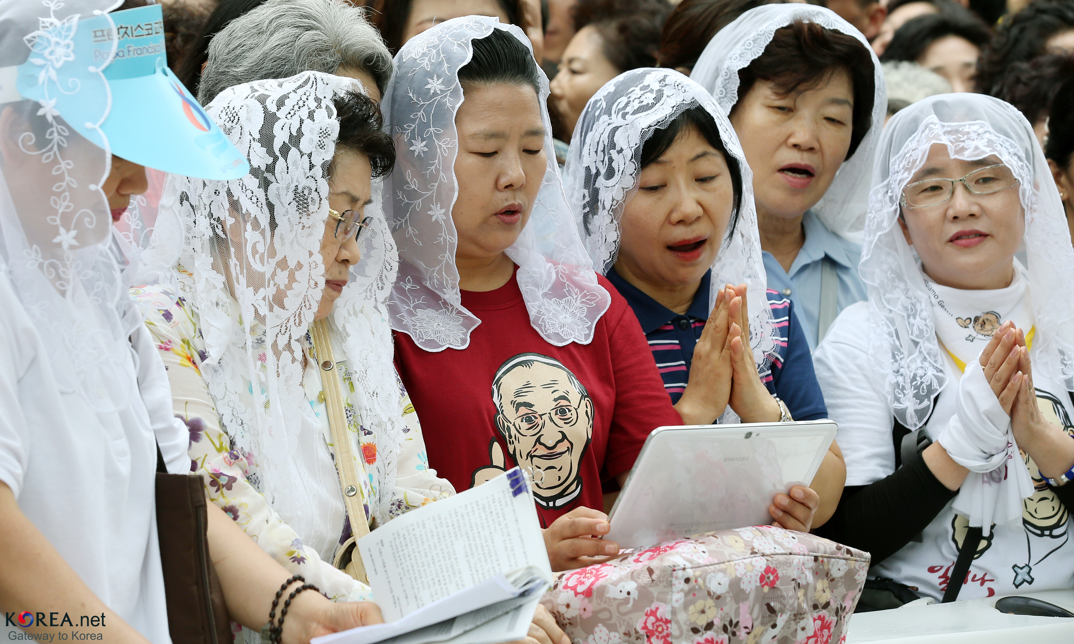
Example: South Korea (2010)
Pew: 46% unaffiliated
“With the presence of several world religions and strong indigenous movements, South Korea is one of the most religiously diverse nations in the world,” with a “shared spirituality” among Koreans.
– Sebastian Kim and Kirsteen Kim (2015)

Slide 7
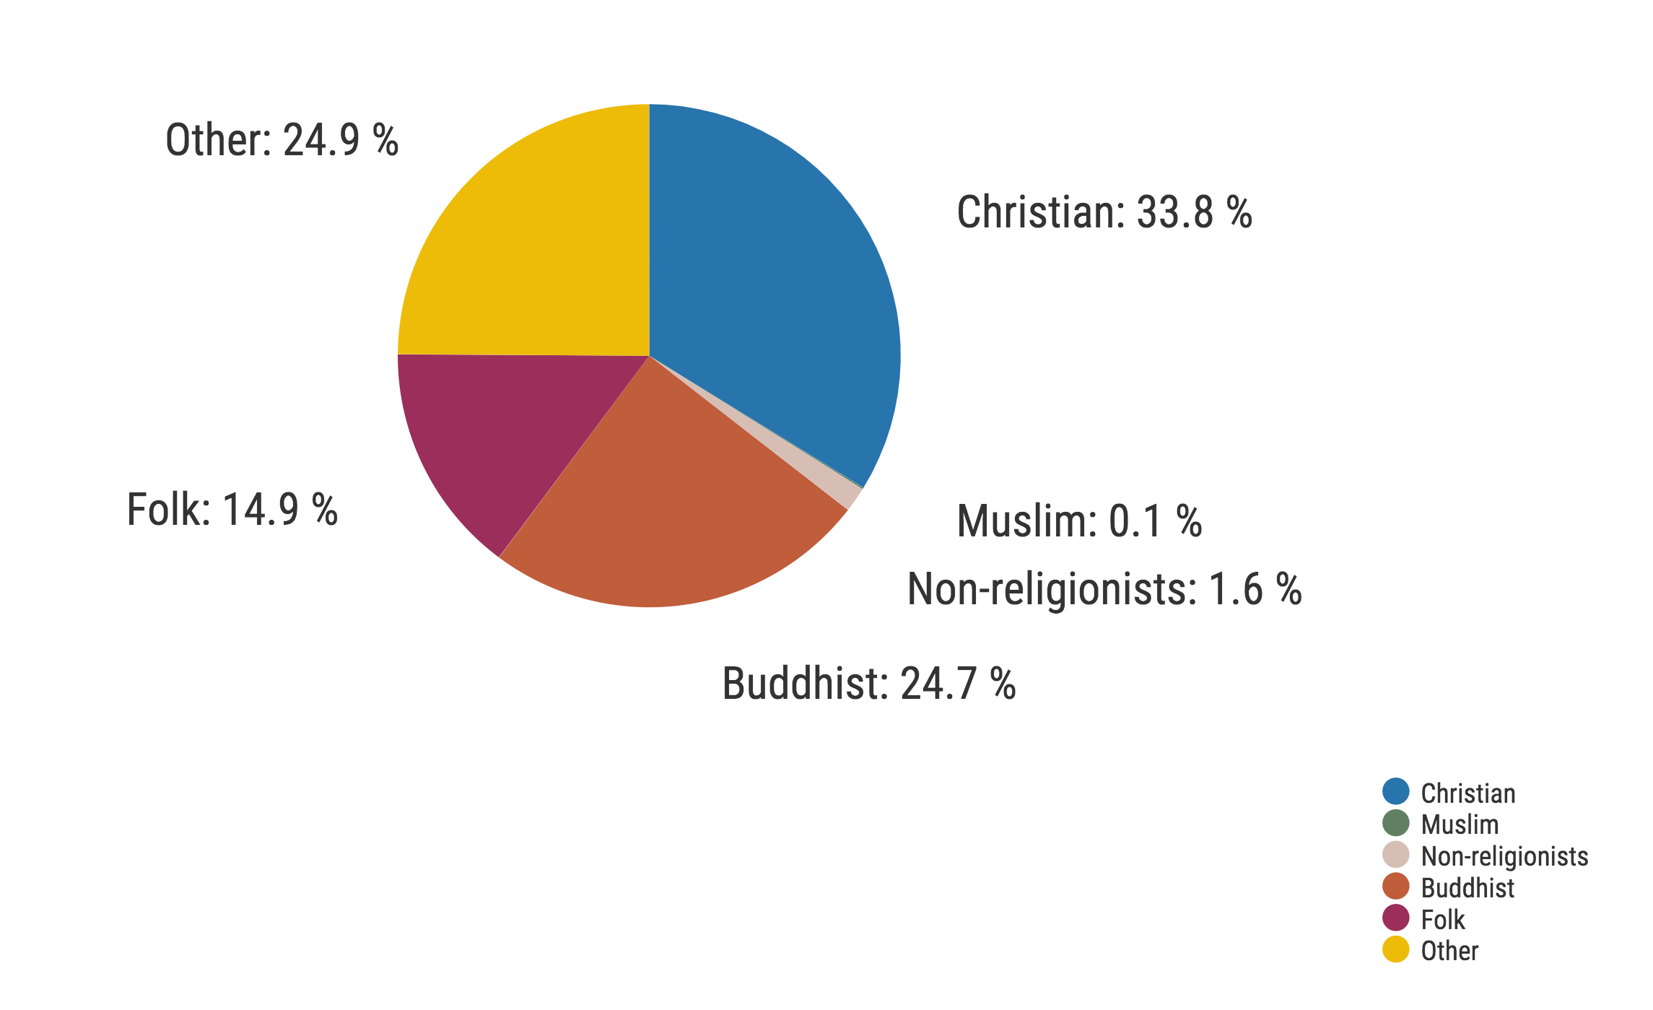
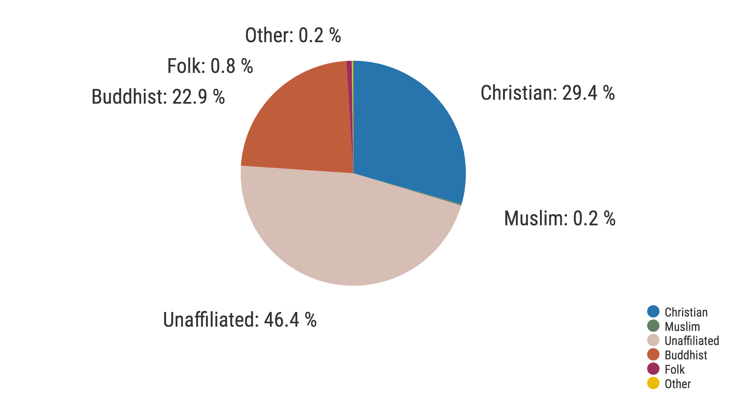
Comparison: South Korea (2010)
South Korea
World Religion Database
South Korea
Pew
WRD other: Baha’i, Confucian, New religions, Shinto

Slide 8
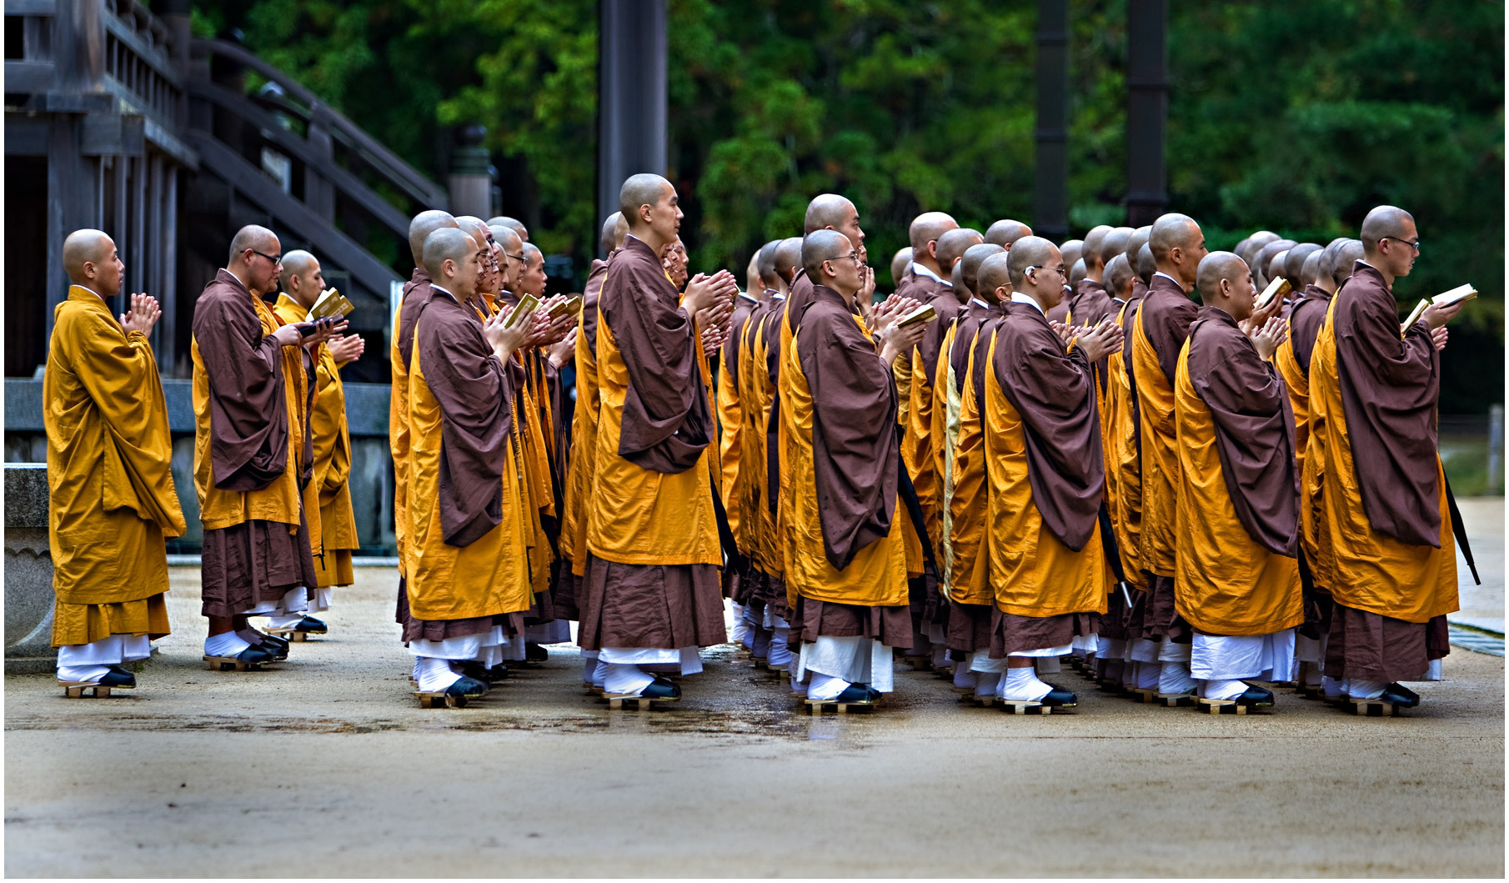

Example: Japan (2010)
Pew: 57% unaffiliated
ISSP: 9% atheist, 19% agnostic

Slide 9
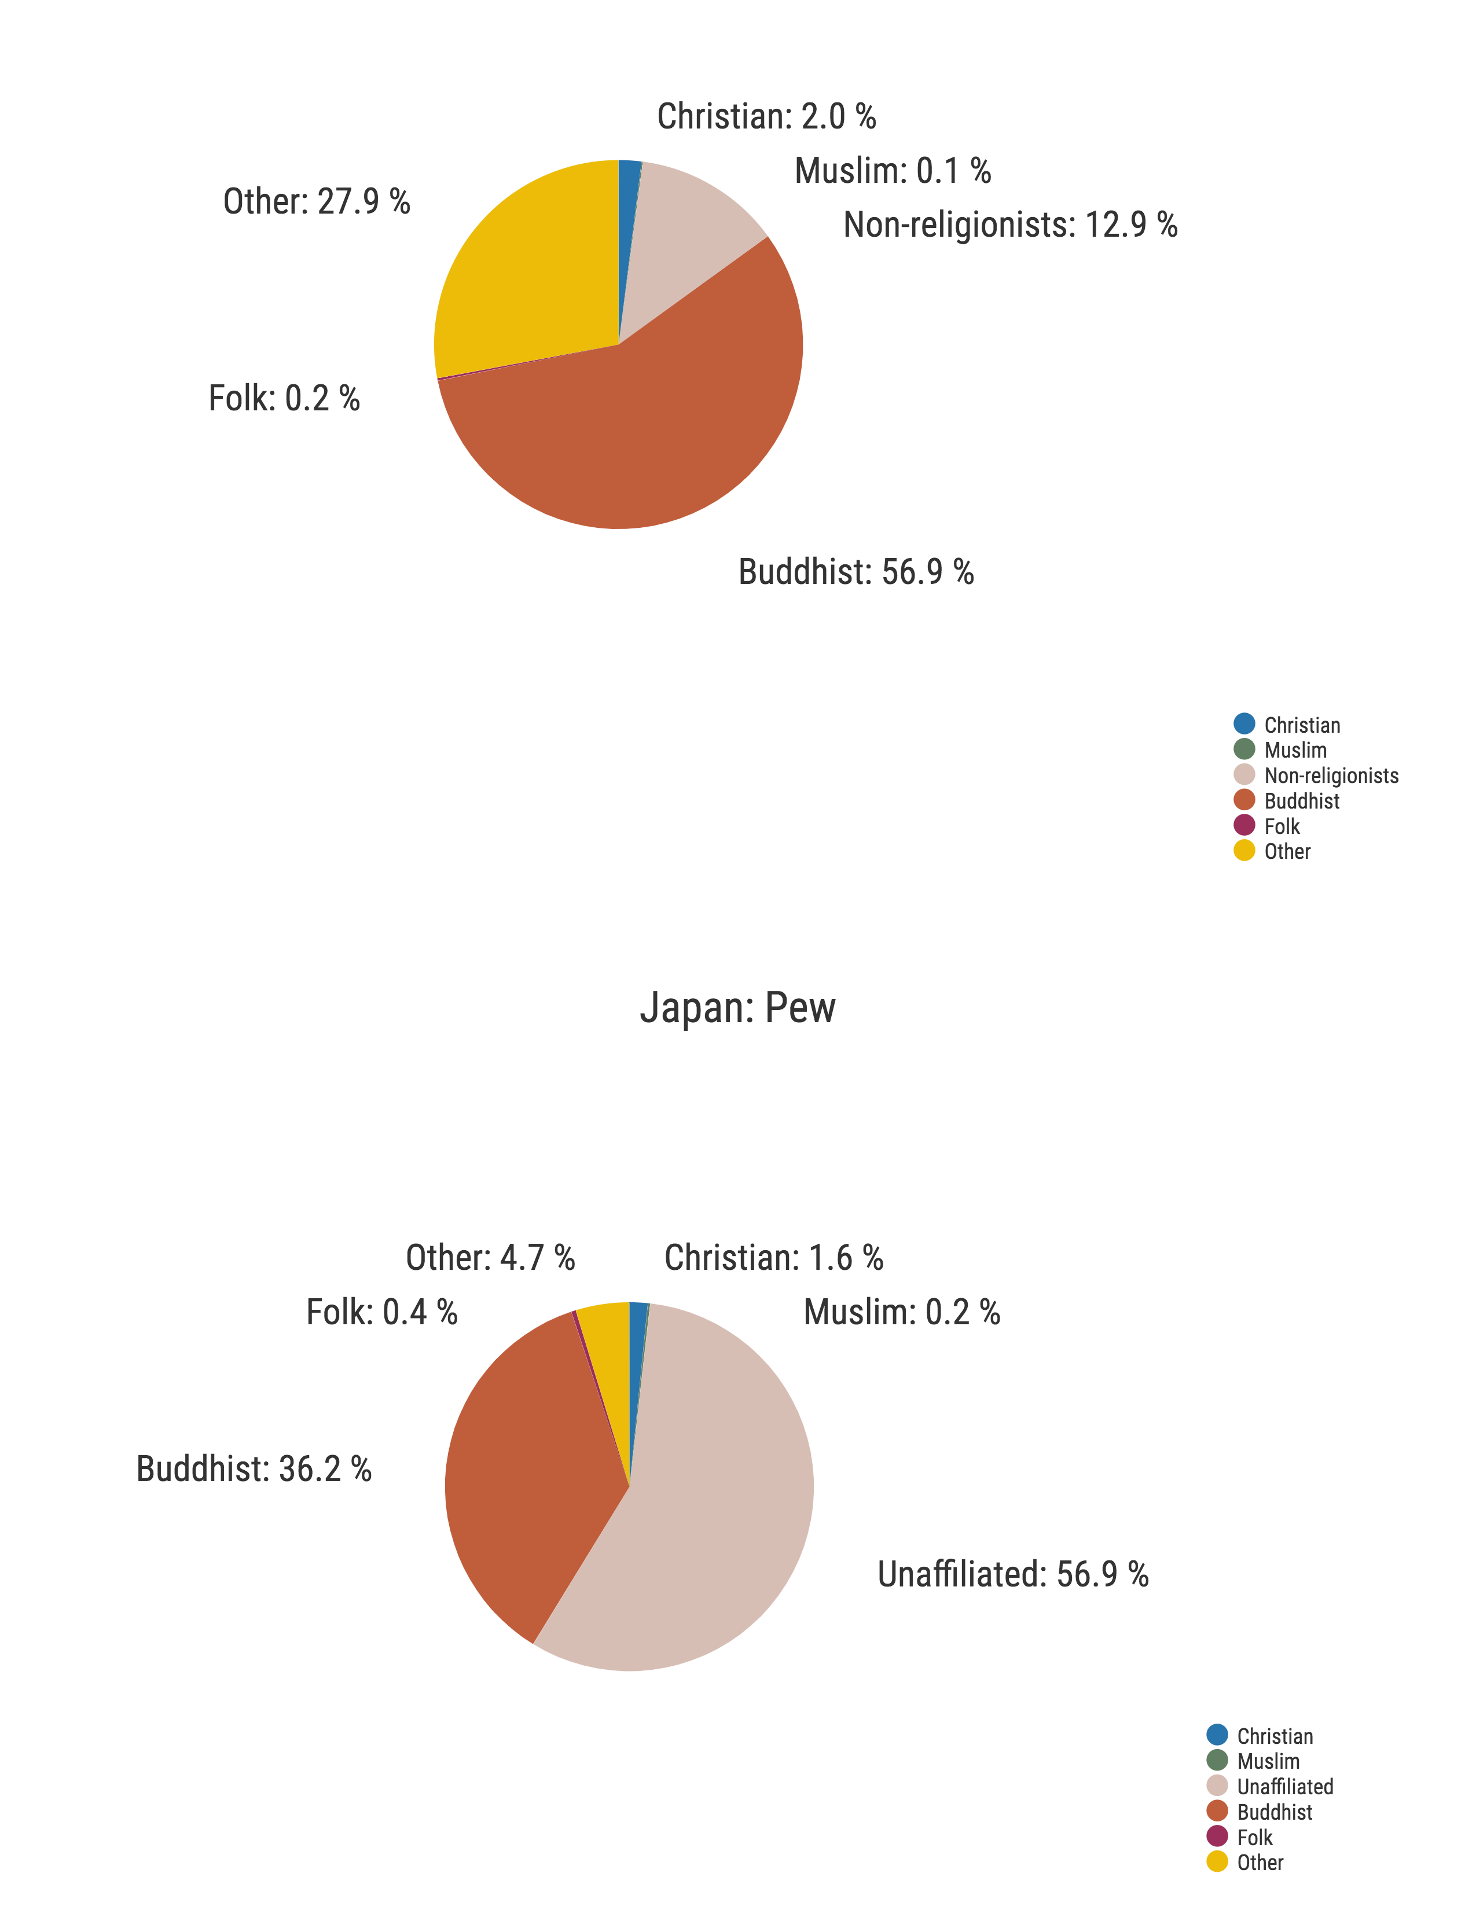
Comparison: Japan (2010)
Japan
World Religion Database
Japan
Pew
WRD other: Baha’i, Confucian, New religions, Shinto

Slide 10
Exploratory data: Asia
Name | Pop_1970 | Pct_1970 | Pop_2010 | Pct_2010 | Pop_2050 | Pct_2050
Religionists | 1,580,694,000 | 74.3% | 3,539,482,000 | 85.0% | 4,634,959,000 | 89.8%
Unaffiliated religious | -- | -- | 237,210,000 | 5.7% | 338,986,000 | 6.6%
Nonreligionists | 547,936,000 | 25.7% | 625,958,000 | 15.0% | 529,103,000 | 10.2%
Atheists | 109,458,000 | 5.1% | 116,068,000 | 2.8% | 98,999,000 | 1.9%
Agnostics | 438,479,000 | 20.6% | 509,890,000 | 12.2% | 430,104,000 | 8.3%

Slide 11
Exploratory data: Global
Name | Pop_1970 | Pct_1970 | Pop_2010 | Pct_2010 | Pop_2050 | Pct_2050
Religionists | 2,983,012,000 | 80.8% | 6,093,911,000 | 88.1% | 8,738,368,000 | 91.5%
Unaffiliated religious | -- | -- | 320,990,000 | 4.6% | 479,250,000 | 5.0%
Nonreligionists | 708,161,000 | 19.2% | 822,272,000 | 11.9% | 812,576,000 | 8.5%
Atheists | 165,156,000 | 4.5% | 137,815,000 | 2.0% | 125,723,000 | 1.3%
Agnostics | 543,004,000 | 14.7% | 684,457,000 | 9.9% | 686,853,000 | 7.2%
28% of the unaffiliated are, perhaps, likely religionists

Slide 12
Conclusion
Who are the unaffiliated?
People who check the “no religion” box on a census or survey form.
Non-religious? Nones?
The conflation of atheism, agnosticism, and “nothing in particular”
is problematic for studying religion in Asia.

Slide 13

Suggestions for further research
Look at religiosity more broadly
Use Eastern standards for recognizing religion, not Western
Mixed methods approaches
Contact
Dr. Gina Zurlo
gzurlo@bu.edu

