Slide 1

Multi-perspective Measurement of Religion in Current China
Weidong Wang
(wwd@ruc.edu.cn)
Renmin University of China
Oct. 11, 2017 , Washington D.C.

Slide 2
Religion Related Survey Projects of NSRC
CGSS
Chinese General Social Survey
2003-2017
Include religion variables and areligion module(2010)
CEPS
China Education Panel Survey
2013-2017
200-2001 cohort, have a religion module in 2017 wave
03
02
04
CRS
China Religion Survey
2013-2015
Focus on religion venues in Mainland China
CSPS
College Student Panel Survey
2009-2013
Have religion modules in 2011 and 2012 waves
01
05
CRABS
Chinese Religion Attitude and Behavior Survey
2016
Religion and no religion half and half design
CLASS
Chinese Longitudinal Aging Social Survey
2014
60 and above respondents’ religion affiliation and activity
06

Slide 3
Ethnicity: A Pitfall of Estimating Chinese Religion Affiliation
.
No religion
Buddhism
Nearly no national representative survey project in China used ethnicity as a stratified variable in sampling design
.
Han and minority have huge difference in religion affiliation, percentage of no religion population in Han is much higher than in minority
Folk religion
Taoism
.
Islam
The percentage of minority population is very low ,but the percentage of minority region in Primary Sampling Units (county level unit) is relative high
Catholicism
Protestantism
.
Ethnicity is a factor to cause overestimating the percentage of religion population or a certain religion in China
.
Design weight and post-stratification weight both are useless in adjusting the error

Slide 4
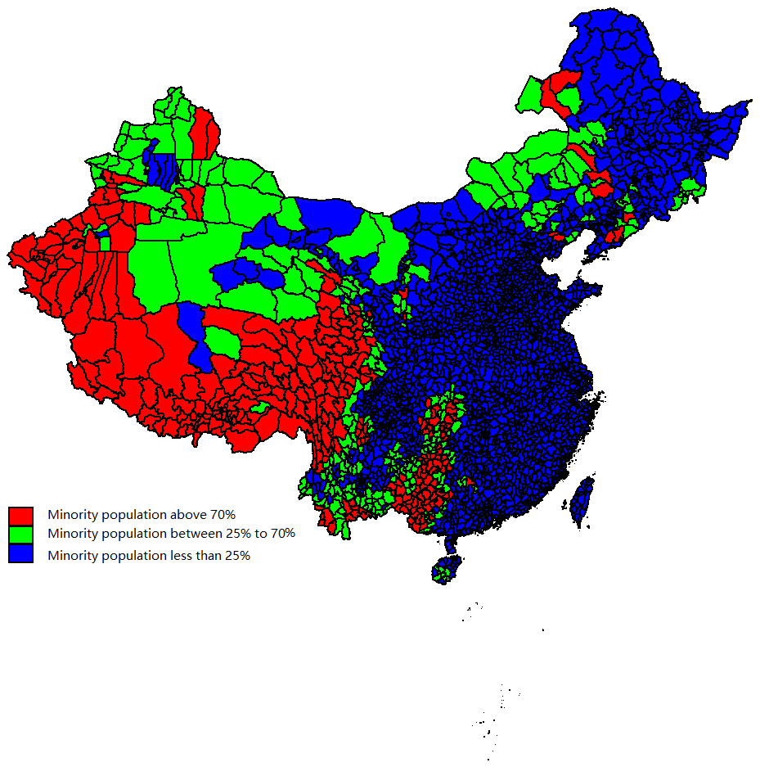
The Population and Region of Minority in China
8.4%
20.1%
Population
County Level Units
According to 2010 Chinese census data, the minority population is 8.4% of total population
According to 2010 Chinese census data, there are 20.1% county level units that minority population is more than 25% in the all 2982 county level units

Slide 5
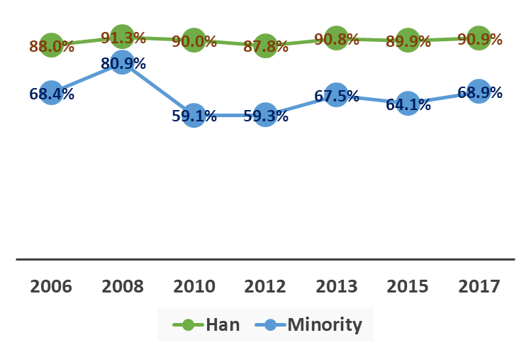
No Religion Population Change in Mainland China
Data source: Chinese General Social Survey (CGSS), 2006 - 2017

Slide 6
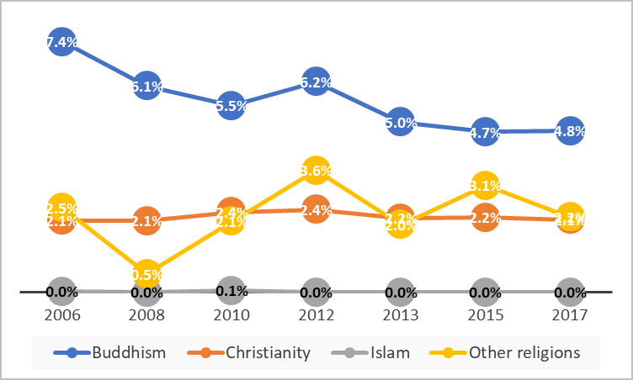
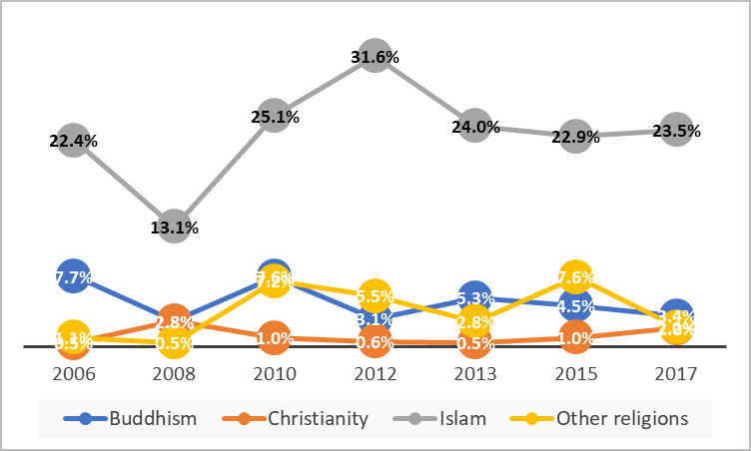
Religion Affiliation Change in Mainland China
HAN
MINORITY
Data source: Chinese General Social Survey (CGSS) ,2006 - 2017

Slide 7
When Did You Confirm Your Religion?
72.5%
70.0%
59.8%
51.3%
27.5%
SINCE BIRTH
18 AND BEFORE
50 AND BEFORE
70 AND BEFORE
HARD TO SAY
35%
65%
Data source: Chinese Religion Attitude and Behavior Survey
(CRABS) , 2016

Slide 8
The Religion Affiliation of Chinese Old People (60+)
90.2%
63.7%
25.2%
6.3%
6.7%
3.0%
0%
0.5%
1.7%
2.7%
HAN
MINORITY
NO RELIGION
BUDDHISM
CHRISTIANITY
ISLAM
OTHER RELIGIONS
Data source: Chinese Longitudinal Aging Social Survey
(CLASS) , 2014

Slide 9
The Religion Affiliation of Chinese millennium Generation
87.5%
86.7%
8.4%
5.5%
2.5%
1.5%
4.0%
0.1%
1.4%
2.4%
HAN
MINORITY
NO RELIGION
BUDDHISM
CHRISTIANITY
ISLAM
OTHER RELIGIONS
Data source: China Education Panel Survey
(CEPS) , religion module of 2017 wave

Slide 10
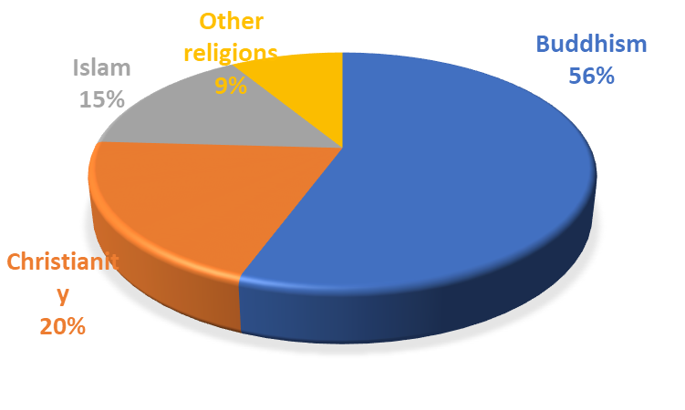
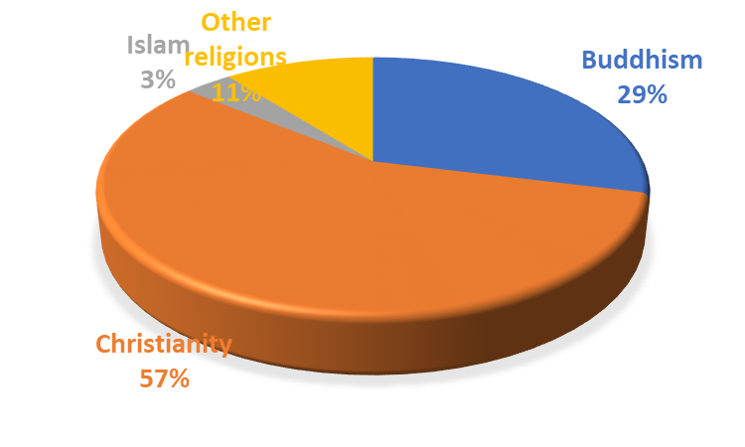
The Religion Affiliation of College Students
8.6% college students reported believing in some religion
56.6% college student believers confirmed their religion in college
Confirm religion before college
Confirm religion in college
Data source: College Student Panel Survey
(CSPS) , 2012 wave

Slide 11
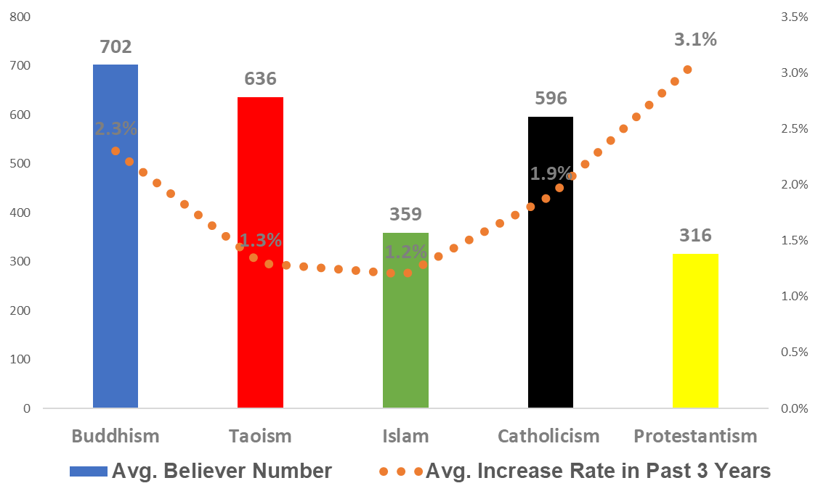
Development of Religion Venues in Mainland China
35%
65%
Data source: China Religion Survey (CRS) , 2013-2015

Slide 12
For More Information:
Thank you for listening
NSRC
*
National Survey Research Center at Renmin University of china
http://nsrc.ruc.edu.cn
*
CGSS
Chinese General Social Survey
http://www.chinagss.org
CRS
China Religion Survey
http://crs.ruc.edu.cn
*
CRABS
Chinese Religion Attitude and Behavior Survey
http://nsrc.ruc.edu.cn/crabs
*
CEPS
Chinese Education Panel Survey
http://ceps.ruc.edu.cn
*
CSPS
College Student Panel Survey
http://csps.ruc.edu.cn

