Slide 1

A cross-cultural dimension of religious belief among eight countries
Akira KAWABATA, Osaka Univ.
Mitsuharu WATANABE, Kanto Gakuin Univ.
OSAKA UNIVERSITY mascot
Dr. Wani
This study was financially supported by the Japan Society for the Promotion of Science
(JSPS KAKENHI Grant Number JP 25244002).

Slide 2
Large difference??
Religion in the West and the East
Japan
Christian Society
Korea
China
Islam

Slide 3
Objectives of our study
To find cross-cultural
commonalities
in religious belief
  For efficient international
  comparative study.
  For understanding
  nation specific characters.
Christian Society
Islam
Commonalities
Japan
China
Korea

Slide 4
Process of questionnaire development
Eliminate culturally dependent terminology
  Jesus, crucifix, heaven, Buddha, Nirvana
Plain and general expressions
  Concentrate one’s attention on a sacred symbol or sacred words (instead of crucifix or amen)
Replace God with “God(s)” in order to eliminate a Christian nuance
  “God(s)” exists externally to human beings.

Slide 5
Three online religious belief surveys
Year | Country | N of items
2010 survey | The US and Japan | 100
2015 survey | Eight countries | 186
2016 survey | Eight countries | 90
Eliminate/modify non-common items
(examples shown later)

Slide 6
2016 survey in eight countries

Slide 7
Common items
(One dimensional structure)

Slide 8
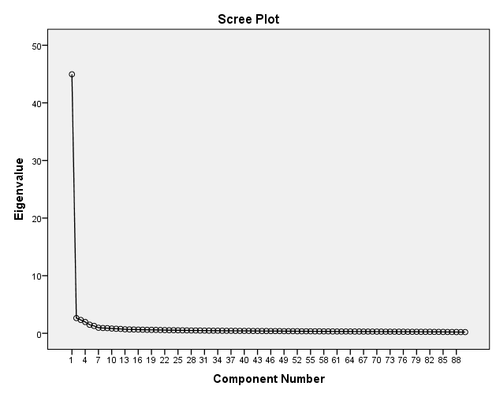
One dimensional religious belief structure
PCA(Principal Components Analysis)
The 1st component is
  Overwhelming
Same pattern in
  All countries
  Both genders
  All age categories
  All educational levels

Slide 9
Easy Common items
Spiritual (free from religious body)
  Supernatural powers and/or miracles exist. 75%
  'God(s)' is a great life force that is one with the universe. 69%
Combination of ethic and transcendence
  There is deep meaning in believing in 'God(s)' and realizing one's desires in this world. 66%

Slide 10
Difficult Common items
Authentic religion (organization or ritual)
  Religious organizations are in and of themselves sacred. 29%
Super transcendental or philosophical
  In order to be saved by 'God(s),' one must deny himself/herself up to the present. 23%

Slide 11
Remarkable common items
Eastern like items
  Everything in this world exists in relation to each other by an invisible power. 60%
Naïve or pre-modern religiosity
  By believing in 'God(s),' one's income can be increased. 24%

Slide 12
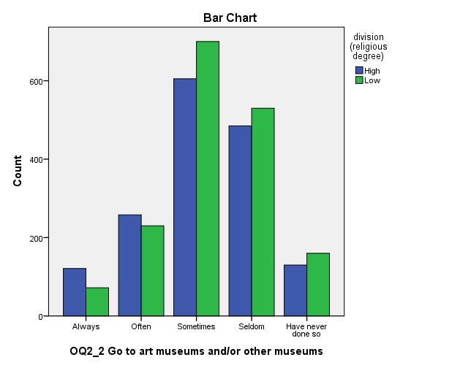
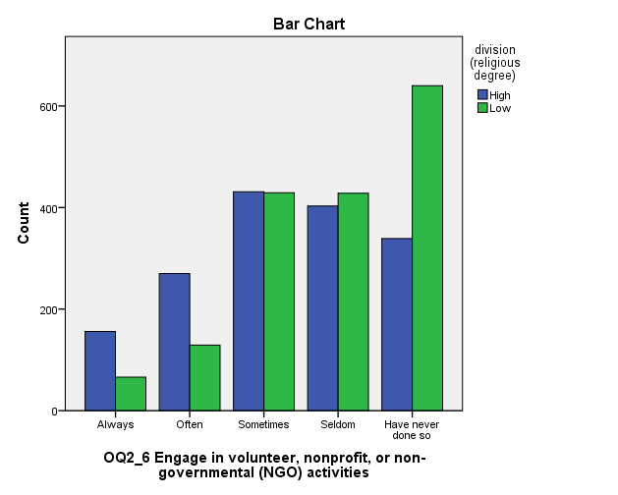
Significant effect on social activities
High culture activities (p<0.01)
Volunteer activities (p<0.01)

Slide 13
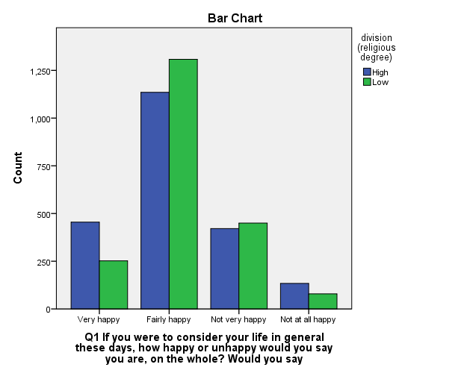
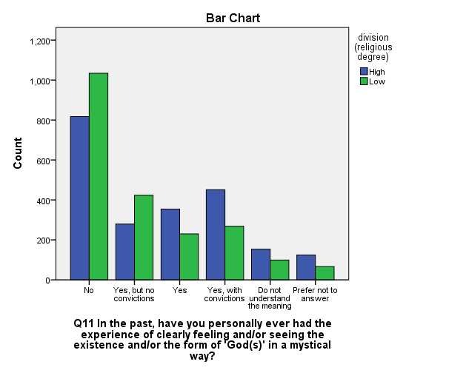
Significant effect on consciousness
Happiness (p<0.01)
Experience of
seeing “God(s)” (p<0.01)
Consequences of Glock and Stark’s
Experience of Glock and Stark’s

Slide 14
Non uniform DIF as specific item
Eastern like items
  The spirits of ancestors and/or dead family members protect their descendants when they are happy and, conversely, when suffering, influence the lives of their descendants negatively.
Protestant like items
  Whether a certain person will be saved or not is individually preordained.

Slide 15
Conclusion
One dimensional commonalities in religious belief
Some nation specific items existed
Commonalities affect happiness, high culture activities, and volunteer activities

